Slide 1
MIT AITI 2004
JSP – Lecture 1
JSP Basics

Slide 2
HTML Review
helloworld.html
<HTML>
<HEAD>
<TITLE>Hello World</TITLE>
</HEAD>
<BODY>
Hello, World!
</BODY>
</HTML>

Slide 3
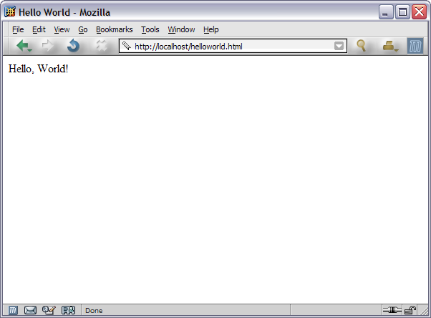
Hello World Snapshot

Slide 4
HTML is Static
HTML page shows the same thing every time you load it in your browser
But you may want the content to change
  Show latest weather, news, scores, etc . . .
  Disallow certain people for logging in
  Remember user’s preferences for future

Slide 5
JSP to the Rescue!
JSP = Java Server Pages
Combines Java and HTML to create dynamic (changing) Web pages
Similar technologies:
ASP, PHP, Perl, Cold Fusion, etc.
But JSP is the only one in Java!
Notes:
Now try <%= "<B>" + now + "</B>" %>

Slide 6
Your First JSP Page
helloworld.jsp
<HTML>
<HEAD>
<TITLE>Hello World</TITLE>
</HEAD>
<BODY>
Hello, World!
</BODY>
</HTML>
Every legal HTML page is a legal JSP page
Notes:
Nothing dynamic about this.

Slide 7
JSP Expressions
JSP Page to show the time of day:
<HTML>
<HEAD>
<TITLE>The Current Date and Time</TITLE>
</HEAD>
<BODY>
The time is now <%=new java.util.Date()%>.
</BODY>
</HTML>
Any Java expression inside <%=. . . %> tags will be printed to HTML

Slide 8
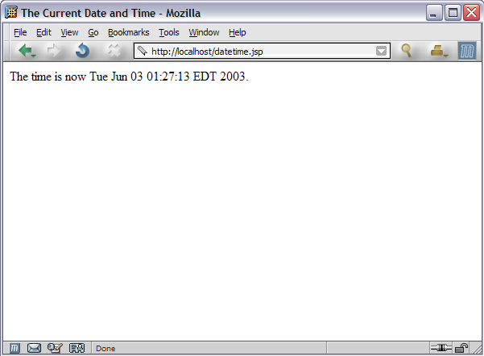
Date and Time Snapshot

Slide 9
JSP Expressions 2
Other examples:
  <%="<B>" + new java.util.Date() + "</B>"%>
  <%= "Hello, World!" %>
  <%= i %>, for some integer variable i
Prints to HTML like System.out.println does:
  for numbers, prints the number
  for booleans, prints "true" or "false"
  for null, prints "null"
  for non-null objects, prints Object.toString()

Slide 10
JSP Scriptlets
Another page to show the current time:
<%
java.util.Date now = new java.util.Date();
%>
<HTML>
<BODY>
The time is now <%= now %>
</BODY>
</HTML>
Java code in <% . . . %> tags executed.

Slide 11
JSP Scriptlets 2
We can intersperse code and HTML
<BODY>
<%
if (Math.random() > 0.5) {
%>
Hello, World
<%
} else {
%>
Goodbye, World
<%
}
%>
</BODY>

Slide 12
JSP Scriptlets 3
Alternatively . . .
<BODY>
<%
String greeting;
if (Math.random() > 0.5) {
greeting = "Hello, World";
} else {
greeting = "Goodbye, World"
}
%>
<%= greeting %>
</BODY>

Slide 13
JSP Scriptlets 4
Example of JSP with iteration
<TABLE>
<%
String[] names = {"Tony", "Sha", "Greg"};
for (int i = 0; i < names.length; i++) {
%>
<tr><td>Name <%=i%>:</td>
<td><%=names[i]%></td></tr>
<%
}
%>
</TABLE>

Slide 14
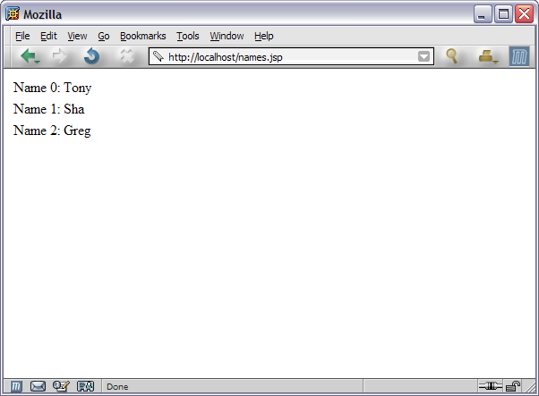
Iteration Snapshot

Slide 15
JSP Declarations
Declare methods and variables that are reused every time the page is loaded.
<%!
int n = 2;
int addn(int i) {
return i + n;
}
%>
<%= addn(5) %>
Q: What does this print to the screen?

Slide 16
JSP Declarations 2
Q: Are these two equivalent?
<% double randomNum = Math.random(); %> <%= randomNum %> | <%! double randomNum = Math.random(); %> <%= randomNum %>
A: No! While the left prints out a new random number each time, the right prints out the same one. Declarations declare variables that are reused on every load.

Slide 17
Page Directive
How do we avoid writing out "java.util.Date"?
In Java, we would write
import java.util.Date;
In JSP, we use a page directive:
<%@ page import="java.util.Date" %>
We will learn other directives in this class.
All use the <%@ . . . %> tags.

Slide 18
Using the Page Directive
<%@page import="java.util.Date" %>
<%
Date now = new Date();
%>
<HTML>
<BODY>
The time is now <%= now %>
</BODY>
</HTML>

Slide 19
Quick JSP Quiz
Which print out the current date on each load?
<% Date d = new Date(); %> <%= d %> | <%! Date d = new Date(); %> <%= d %>
<%! Date d = new Date(); Date getDate() { return d; } %> <%= getDate() %> | <%! Date getDate() { return new Date(); } %> <%= getDate() %>

Slide 20
JSP Review
Expressions <%= . . . %>
  Prints a Java Expression to HTML
  Example: <%= new Date() %>
Scriptlets <% . . . %>
  Executes Java code block
  Example: <% Date now = new Date() %>
Declarations <%! . . . %>
  Declare global methods and variables
  Example: <%! Date getDate() {return new Date();} %>
Page Directive <%@ page import = . . . %>
  Imports a Java class or classes
  Example <%@ page import="java.util.Date" %>

